Slide 1

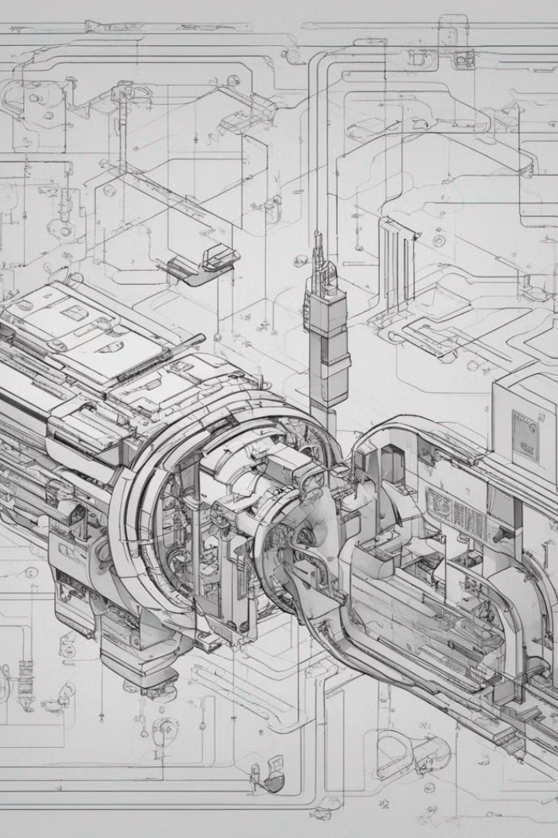
Dynamic Adaptive Optimization in a compiler
Dynamic Adaptive Optimization is a crucial concept in compiler design, aiming to enhance code performance. It involves adjusting code execution at runtime based on the actual behavior of the program.
By
V. Bala Karthik(192210301)
A. Vishnu Vardhan(192210390)

Slide 2

What is a compiler?
1
Definition
2
Processing
A compiler is a software program that translates code written in a high-level language to machine code.
Compilers analyze, optimize, and generate efficient executable code for various platforms.
3
Role
They play a critical role in the software development process, ensuring code efficiency and performance.

Slide 3
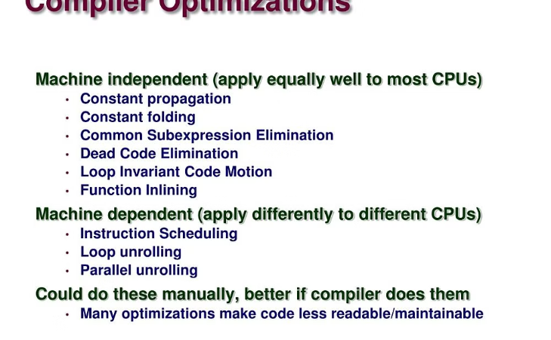
The need for optimization in compilers
Enhancing Performance
Optimization mitigates overheads, reduces execution time, and enhances program efficiency.

Slide 4

Understanding dynamic adaptive optimization
Runtime Adaptation
Feedback Mechanisms
It involves making runtime decisions about optimizing code based on actual program behavior.
Systems collect feedback and react dynamically, adjusting their optimization strategy.

Slide 5
Techniques used in dynamic adaptive optimization
Profiling
Adaptive Code Generation
Collecting data about program performance and resource usage to guide optimization.
Creating machine code during execution, tailored to the specific program behavior.

Slide 6




Benefits of dynamic adaptive optimization in compilers
Enhanced Performance
Adaptability
Resource Efficiency
It allows compilers to respond to changes in workload or application behavior.
By tailoring optimization to actual program behaviors, resources are used judiciously.
Optimized code execution leads to faster and more efficient software.

Slide 7

Challenges and limitations of dynamic adaptive optimization
Complexity
Overhead
Implementing adaptive optimization introduces significant complexity to compilers.
Runtime adaptation can introduce overhead and affect program performance negatively.

Slide 8
Conclusion and future directions
2
3
Continued Research
Integration
Ongoing research aims to address challenges and further refine adaptive optimization techniques.
Integrated development environments are likely to incorporate more adaptable and efficient compilation strategies.

